Slide 1
Capacitive Proximity Sensors Accelerometer

Slide 2
Capacitive Proximity Sensors as accelerometer
Accelerometers utilize the properties of an opposed plate capacitor for which the distance between the plates varies proportionally to applied acceleration, thus altering capacitance.
Capacitive accelerometers are capable of measuring constant as well as slow transient and periodic acceleration.
This variable is used in a circuit to ultimately deliver a voltage signal that is proportional to acceleration.
Capacitive-acceleration sensors fundamentally contain at least two components;
The primary is a ‘stationary’ plate.
the secondary plate is attached to the inertial mass, which is free to move inside the housing.
These plates form a capacitor whose value is a function of a distance d between the plates.

Slide 3
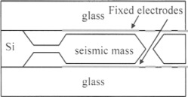
Capacitive Proximity Sensors as accelerometer

Slide 4
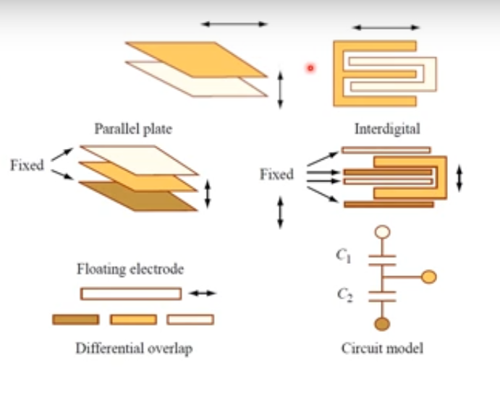
Capacitive Proximity Sensors as accelerometer

Slide 5
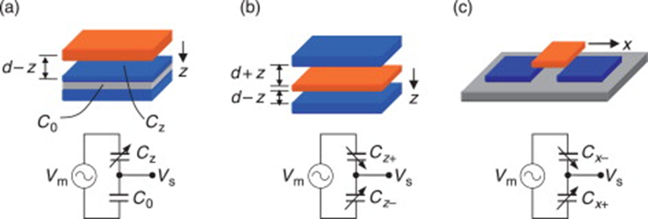
Capacitive Proximity Sensors as accelerometer

Slide 6
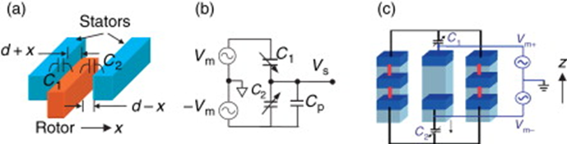
Capacitive Proximity Sensors as accelerometer

Slide 7
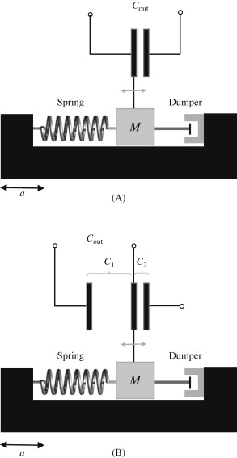
Capacitive Proximity Sensors as accelerometer

Slide 8
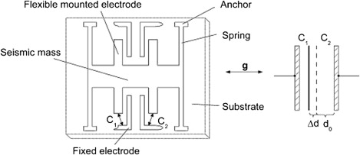
Capacitive Proximity Sensors as accelerometer

Slide 9
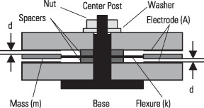
Capacitive Proximity Sensors as accelerometer

Slide 10
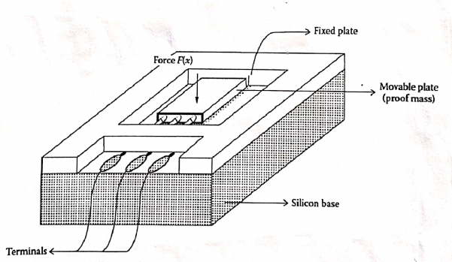
Capacitive Proximity Sensors as accelerometer

Slide 11
Capacitive Proximity Sensors as accelerometer
Advantages
High sensitivity,
Good temperature performance,
Low fabrication cost,
Small size
Easy integration with CMOS.
Capacitive displacement sensing structures are very simple.

Slide 12
Capacitive Proximity Sensors Applications
Applications
Air-bag control systems in automobiles.
Smart Phone Motion sensing.
Measuring the static tilt.
Medical Applications.
Predictive maintenance.
Aerospace

Slide 13
Inductive Proximity Sensors Accelerometer

Slide 14
Inductive Proximity Sensors as accelerometer

Slide 15
Inductive Proximity Sensors as accelerometer
The accelerometer consists of fixed planar spiral inductor that has been sandwiched between two ferromagnetic layers.
One of the layers is under the planar coil and the other one is attached to the proof-mass of the accelerometer.
The principle of the design is based on the inductance variation due to vertical distance changing between the ferromagnetic layers.

Slide 16
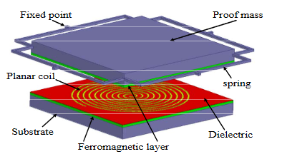
Inductive Proximity Sensors as accelerometer

